Slide 1
Hands-on introduction to targeted spatial transcriptomics data analysis
Arne Defauw
Frank Vernaillen
Julien Mortier

Slide 2

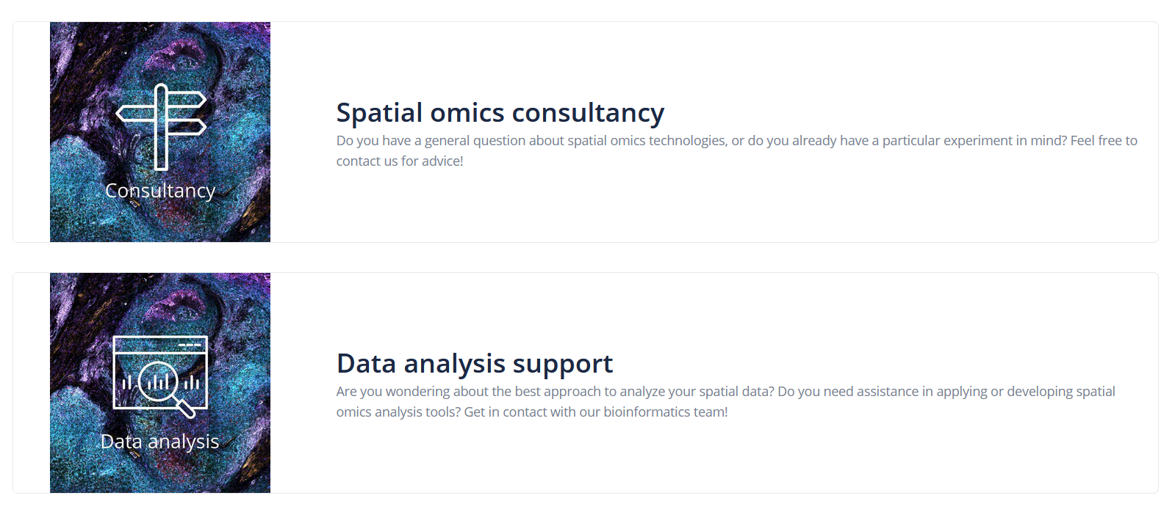
Who are we?
VIB Spatial Catalyst
https://connect.vib.be/facilities/spatial-catalyst/

Slide 3
Previous training
how to start with spatial omics: https://elearning.vib.be/courses/sp/

Slide 4
Targeted VS Untargeted
Spatial technologies
= Some markers of interest
In situ detection using detection probes
Imaging based
= ‘Full’ transcriptome/proteome
Unbiased detection
Sequencing or mass spectrometry based
Validation
Discovery

Slide 5
Spatial technologies
Targeted transcriptomics
Merscope (Vizgen), Xenium (10X Genomics), Molecular Cartography (Resolve Biosciences), CosMx (NanoString), GenePS (Spatial Genomics), Pyxa (Stellaromics), …
Untargeted transcriptomics
Visium (HD) (10X Genomics), Stereo-seq (BGI), Nova-ST (Aerts lab), …
Targeted proteomics
MACSima (Miltenyi Biotec), PhenoCycler Fusion (Akoya), OPAL (Akoya), COMET (Lunaphore), MIBIscope (Ionpath), …
…

Slide 6
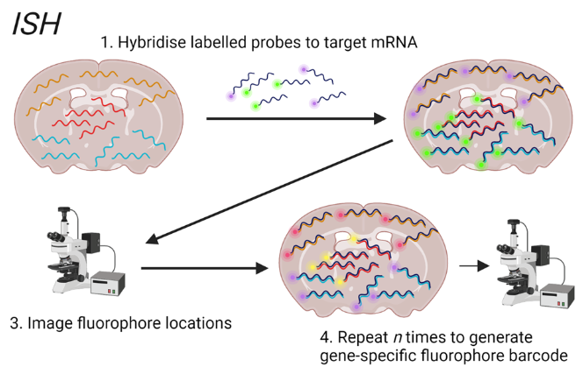
Targeted transcriptomics

Slide 7
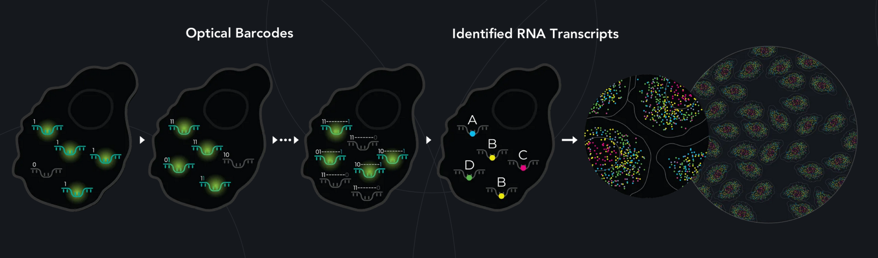
Targeted transcriptomics
Merscope

Slide 8
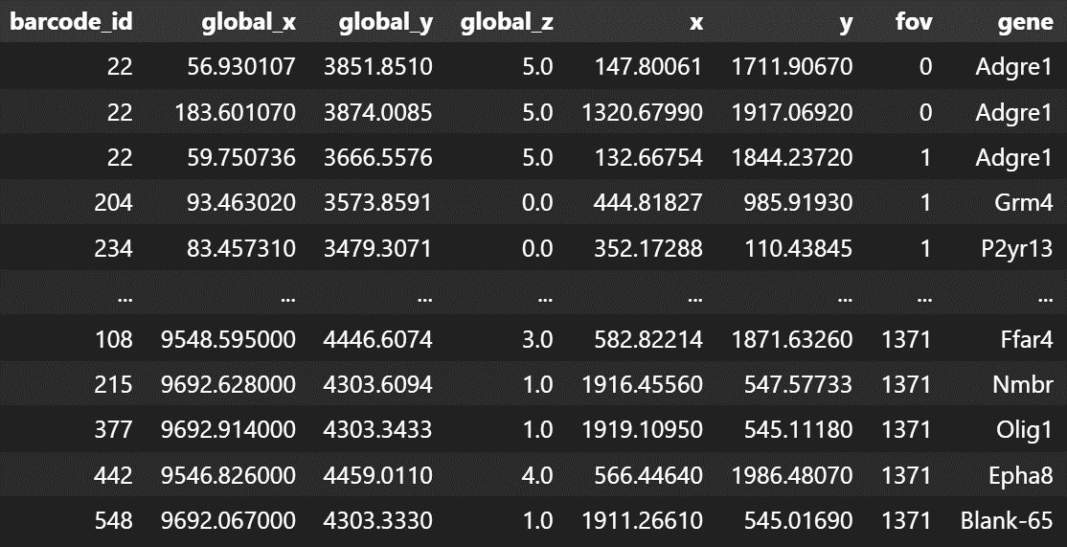
Targeted transcriptomics
Typical raw data: List of transcript identities and coordinates + DAPI image
DAPI
Transcripts

Slide 9



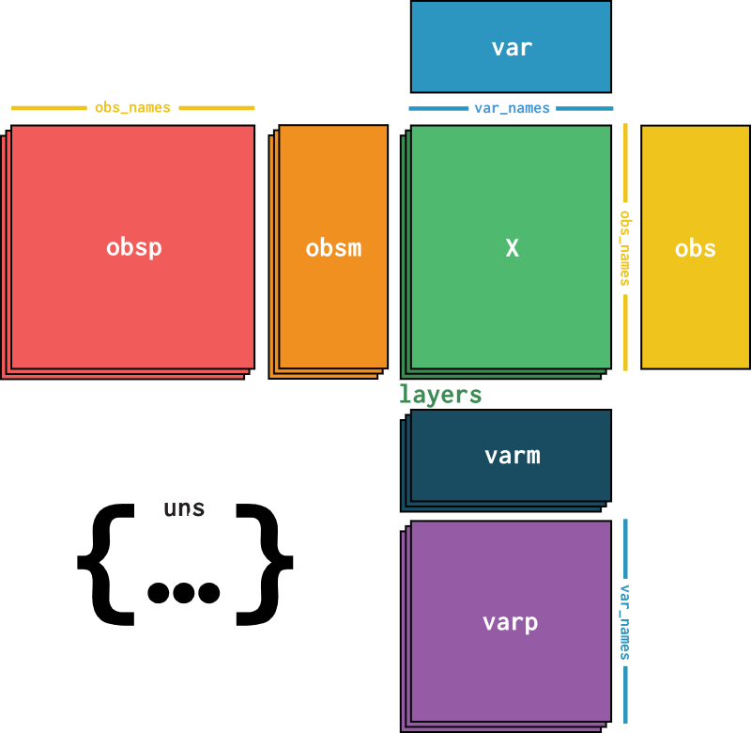

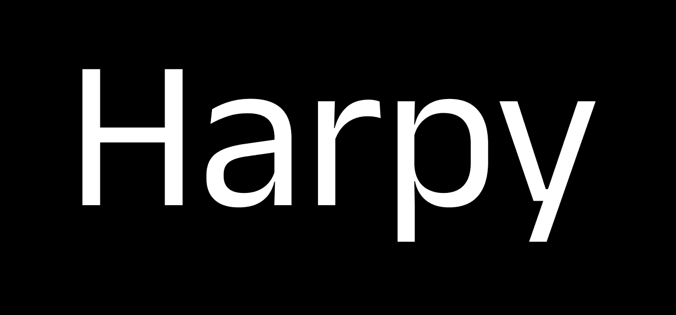
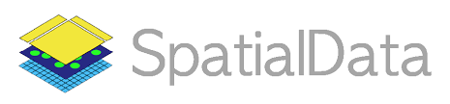

Python packages
Scverse: https://scverse.org/
AnnData: https://anndata.readthedocs.io/
Scanpy: https://scanpy.readthedocs.io/
Squidpy: https://squidpy.readthedocs.io/
SpatialData: https://spatialdata.scverse.org
SPArrOW: https://sparrow-pipeline.readthedocs.io/
Harpy: https://harpy.readthedocs.io/en/latest/
…

Slide 10


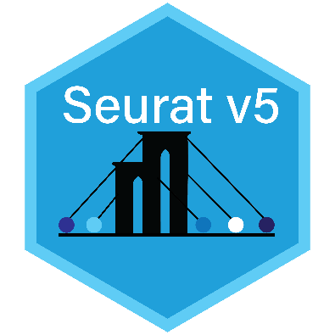

packages
Bioconductor: https://www.bioconductor.org/
Seurat: https://satijalab.org/seurat/
Giotto Suite: https://drieslab.github.io/Giotto_website/
…

Slide 11
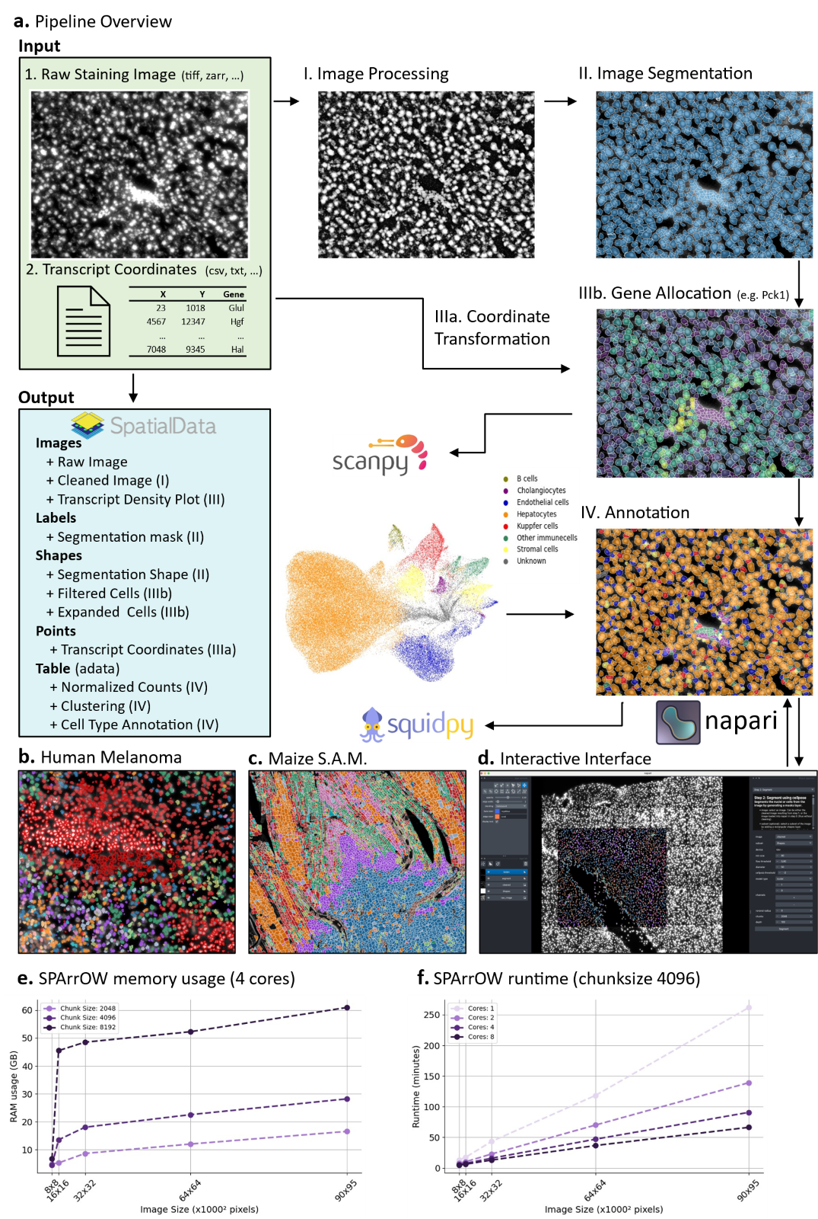

Developed by Lotte Pollaris (Yvan Saeys lab) in collaboration with Spatial Catalyst
A flexible, interactive and scalable pipeline for targeted spatial transcriptomics analysis

Slide 12
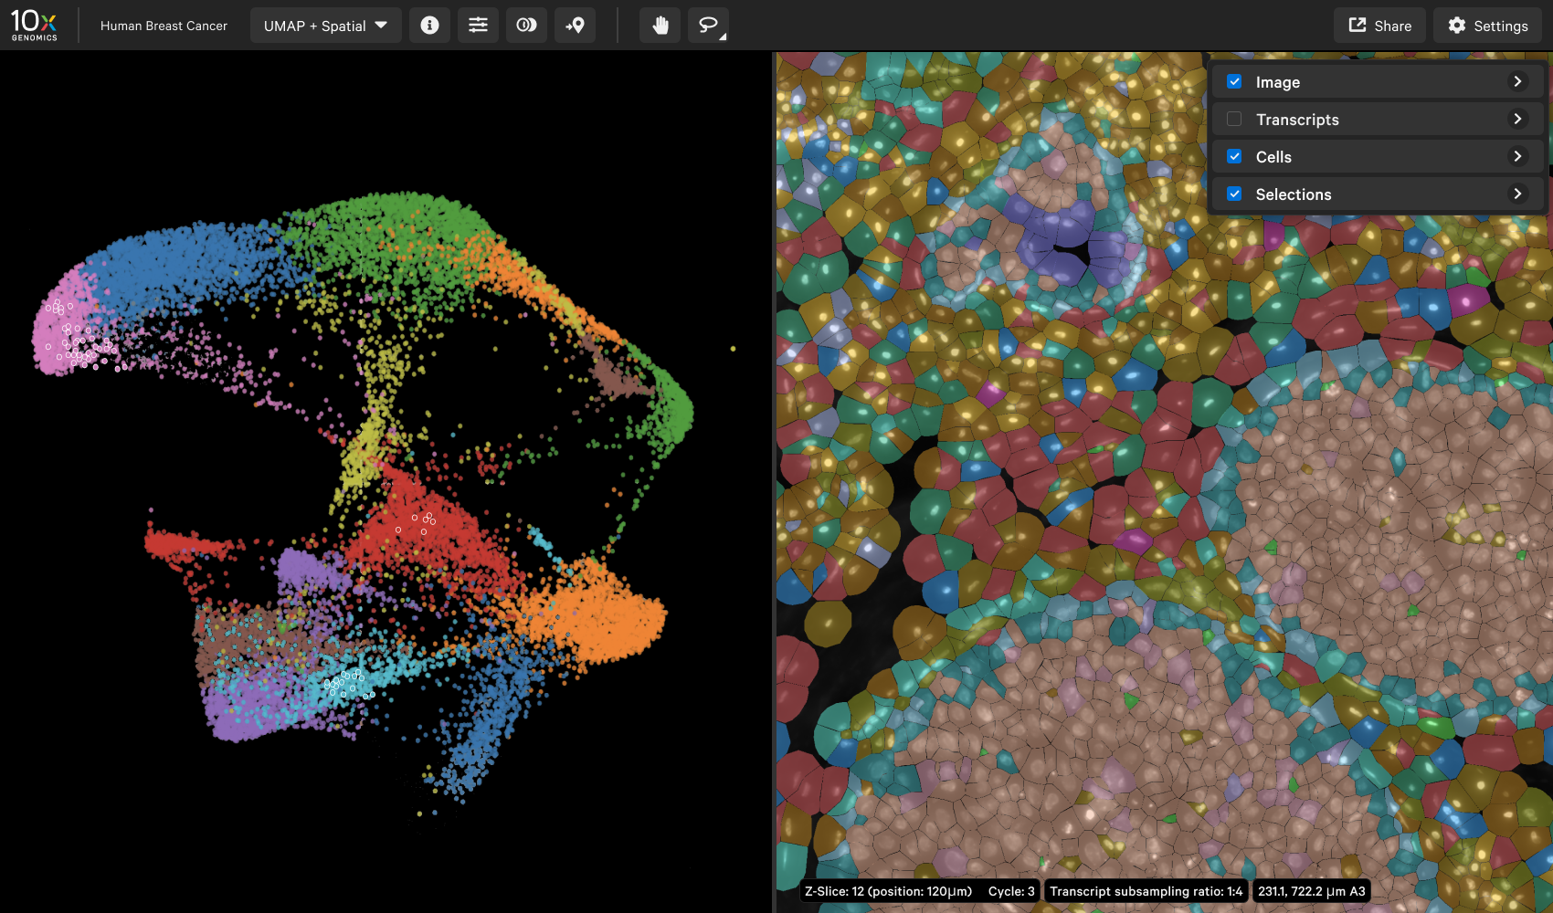
vs. commercial visualizers
Xenium explorer

Slide 13
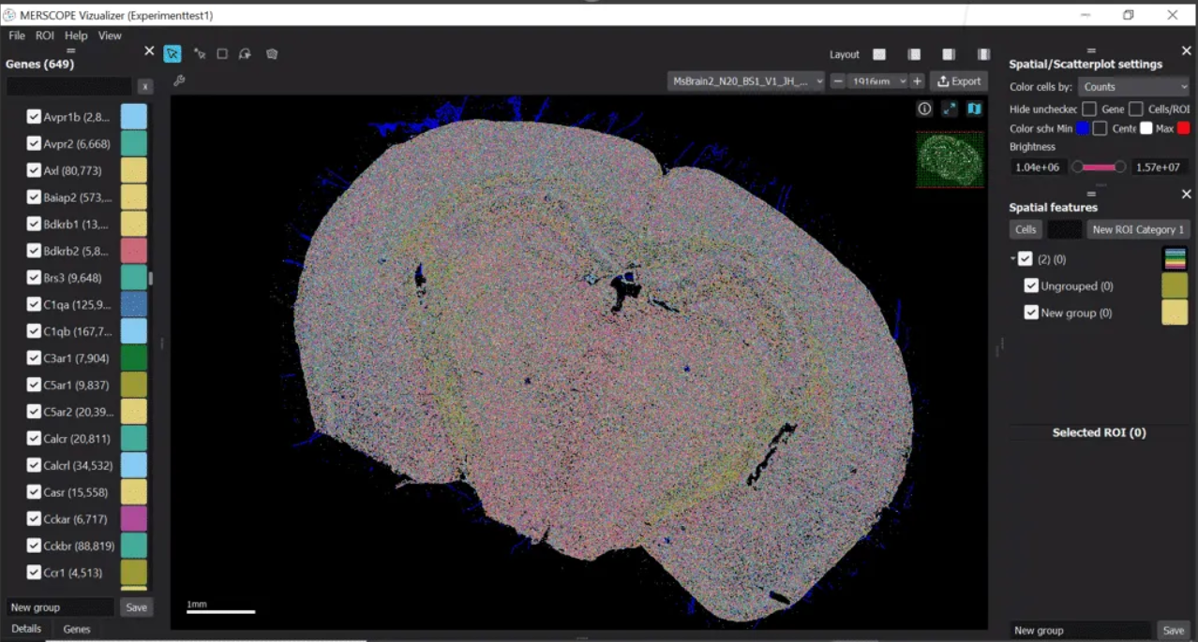
vs. commercial visualizers
Merscope visualizer

Slide 14
vs. commercial visualizers
Pros of commercial visualizers:
Quick
GUI
Interactive exploration of the data
Cons of commercial visualizers:
Learning curve
Not universally applicable
Limited functionality and not state-of-the-art
Not optimized for your tissue and research questions

Slide 15
vs. commercial visualizers
Pros of SPArrOW:
Developers are in-house for support and functionality requests
Flexible framework that is expandable to multiple samples, multi-omics, …
Easy integration with state-of-the-art open-source tools
Transparency
Coding
Cons of SPArrOW:
Learning curve (i.e.: coding)

Slide 16

Harpy
Under development by Benjamin Rombaut (Yvan Saeys lab) in collaboration with Spatial Catalyst
Broadens the capabilities of SPArrOW for proteomics, multi-omics, …

Slide 17
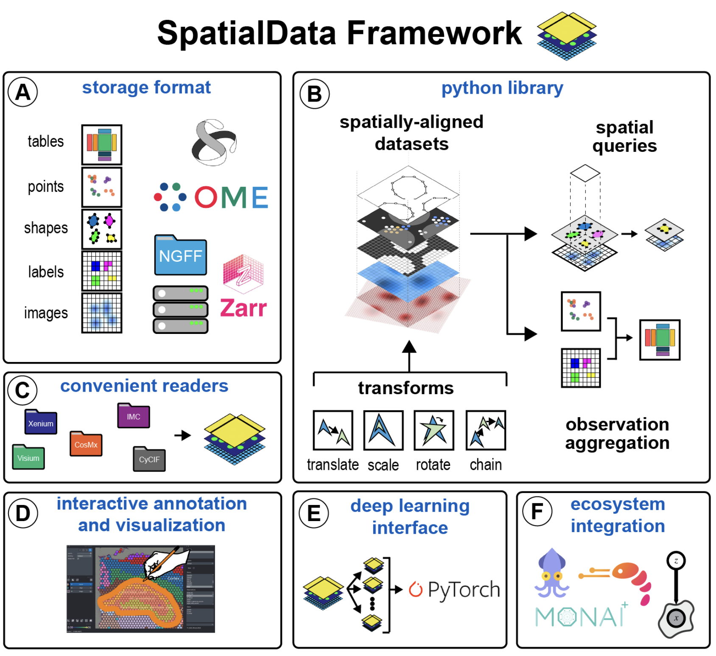
SpatialData
Data framework

Slide 18
SpatialData
Data framework that handles data storage format, access, alignment in different coordinate spaces, processing operations…
Napari plugin for interactive annotation and visualization

Slide 19
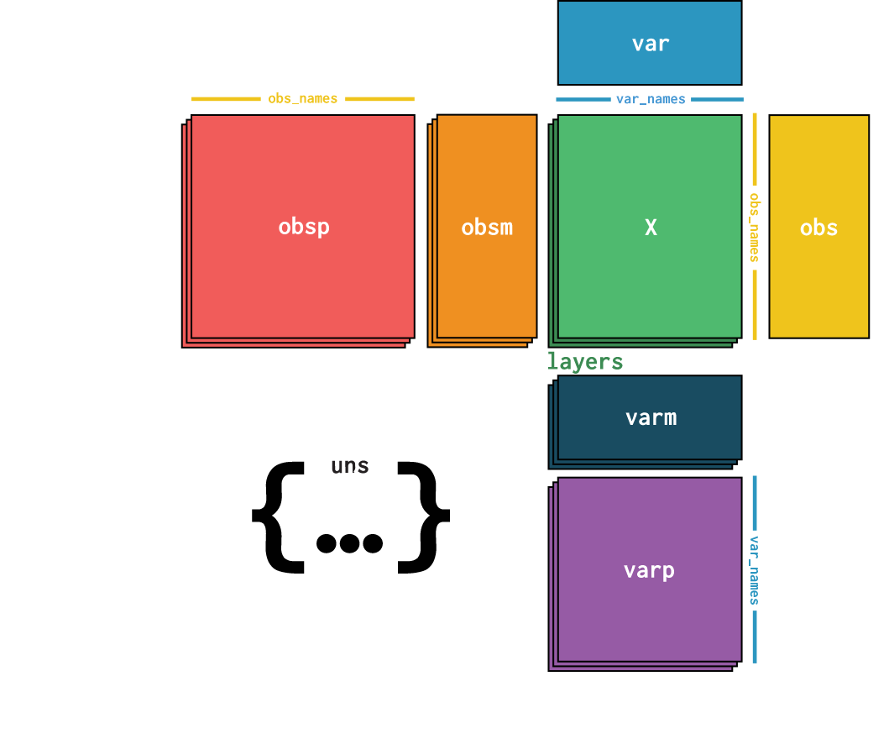
AnnData
X: feature matrix containing observations as rows and variables as columns.
obs: One-dimensional annotations about the observations (e.g. cell-size, cell type, …).
var: One-dimensional annotations about the variables (e.g. gene function, …).
obsm: multi-dimensional representations (e.g. PCA, UMAP, spatial coordinates, …).
varm: multi-dimensional representations (e.g. PCs).
obsp: pair-wise relations (e.g. spatial graphs).
varp: pair-wise relations.
uns: unstructured data.

